Slide 1
Big Data, Emergent Laws and Objective Knowledge
Knowledge in the form of
“descriptions of until now always observed patterns“
as basis for prediction- and decisionmodels
André Kuck and Norbert Kratz
Duale Hochschule Baden-Württemberg
Villingen-Schwenningen

Slide 2
Content Overview
Übersicht
0. Introduction 1. Objective Knowledge and Falsifiable Predictions - Asset Price Inflation 2. Combination of Laws and Objects – Returns at Lending Club
3. Comparison with Machine Learning Algorithms
4. Reliability and Meta-Laws

Slide 3
0. Introduction
Within empirical science knowledge is based on observations and experience.
Empirical Laws have to refer to observable data, as otherwise no falsifiability is ensured.
The search for Empirical Laws implies the search for laws, that were always true until now.
However this justifies the confidence, that these laws will be true in the future as well (until they are possibly falsified forever).

Slide 4
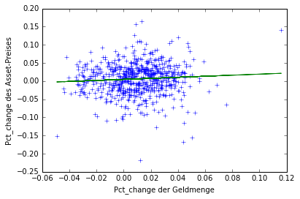
1. Objective Knowledge and Falsifiable Predictions - Asset Price Inflation
Does an increase of money supply trigger an increase of asset prices?
Does the so-called „Asset Price Inflation“ exist?
$r_{S\&P,t}=\frac{P_{S\&P,t+lp}}{P_{S\&P,t}}−1, r_{M_{i},t}=\frac{M_{i,t}}{M_{i,t−lM}}−1$
Regression equation: (C_SU(t+1)/C_SU(t)-1) = 0.0049 + 0.144 * (M1_US(t)/M1_US(t-2)-1))

Slide 5
1. Objective Knowledge and Falsifiable Predictions - Asset Price Inflation
Temporal Structure
Calculation of rolling statistics, with a time frame T=3
t=1
t=2
t=3
t=4
t=5
t=6
t=7
t=8 t=9
T=3
T=3
T=3
degree of inductive verification = 2

Slide 6
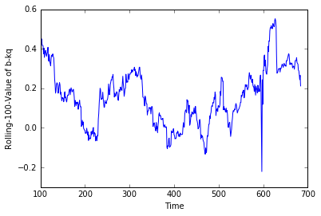
1. Objective Knowledge and Falsifiable Predictions - Asset Price Inflation
Rolling Regression in time frames of length T:
$r_{S\&P,t}=a_{t,T}+b_{t,T}r_{M_{i},t} with b_{t,T}=\frac{{Cov}_{T} (r_{S\&P,t},r_{M_{i},t})}{{Var}_{T} (r_{M_{i},t})}$
Result: No emergent law for T=100 exists.

Slide 7
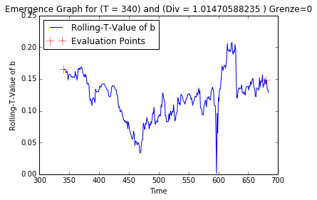
1. Objective Knowledge and Falsifiable Predictions - Asset Price Inflation
Question: Does a time window T (in months) exist, with: $∀t\left(b_{t,T}≥0\right)?$
Answer: For every $T≥340$ $b_{t,T} was always ≥0$ Thus an emergent law exists..
Emergent Law: An until now always true statement about a function of sequences of observations.

Slide 8
1. Objektives empirisches Wissen und überprüfbare Prognosen - Asset price inflation
1. Objective Knowledge and Falsifiable Predictions - Asset Price Inflation
Exemplary results for different asset classes and monetary aggregates
Law | Index | Money Supply | Lead_Index | Lag_Money | bmean | amean | T | DiV | minb | maxb
1 | C_DAX | M2_DE | 1 | 1 | 0.141446 | 0.004193 | 207 | 1.096618 | 0.017764 | 0.66626
2 | C_DJ | M1_US | 1 | 2 | 0.153689 | 0.001196 | 276 | 1.481884 | 0.003893 | 0.268785
3 | C_FT | M1_GB | 1 | 1 | 0.229354 | 0.002835 | 127 | 1.779528 | 0.036166 | 0.444704
4 | C_KDAX | M1_DE | 1 | 1 | 0.26251 | 0.003029 | 126 | 1.698413 | 0.015675 | 0.961231
5 | C_NI | M0_JP | 1 | 2 | 0.074657 | 0.000101 | 111 | 2.486486 | 0.001588 | 0.215611
6 | C_REX | M1_DE | 1 | 3 | 0.031969 | 0.000733 | 117 | 1.538462 | 0.002671 | 0.080531
7 | C_SU | M1_US | 1 | 2 | 0.135949 | 0.00289 | 341 | 1.008798 | 0.003605 | 0.195077
8 | Case_home | M2_US | 1 | 6 | 0.069875 | 0.001627 | 242 | 1.045455 | 0.000984 | 0.10708
For every index there exists a combination of monetary aggregate, lag ($lM$) and set of emergence ($T≤340$) for which the slope of the regression between the index return and the preceding increase of monetary supply was always greater than (or equal) 0.
There exists no combination of monetary aggregate, lag ($lM$) and set of emergence ($T≤TG/2$) for which the slope of the regression between the index return and the preceding increase of monetary supply was always smaller than (or equal) 0.
In this sense Asset Price Inflation exists as a pattern that was – until now – always observed.

Slide 9
1. Objektives empirisches Wissen und überprüfbare Prognosen - Asset price inflation
1. Objektives empirisches Wissen und überprüfbare Prognosen - Asset price inflation
1. Objective Knowledge and Falsifiable Predictions - Asset Price Inflation
Emergent Laws are objective, no assumption about the truth of a given probability distribution is involved.
The following simple induction principle can be used to derive predictions:
„ Only what was true until now, can be true in general.“
Predictions made on the basis of emergent laws are objective and definitely falsifiable because they were not immunized against exact falsification by simply assuming the truth of a probability distribution.

Slide 10
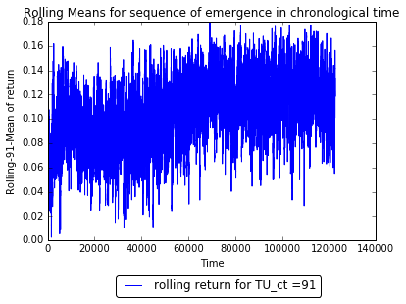
2. Combination of Laws and Objects – Returns at Lending Club
Example: Returns of the peer-to-peer lending platform „Lending Club“
(122,444 loans from 2007-2013, respectively with a duration of 36 months)
return = entire payments / entire amount paid out - 1
Question:
If a portfolio is constructed with sequences of loans, is there a minimum portfolio size so that the portfolio return was never negative?
Answer:
For $T≥91=TU$ was ${\overline{r}}_{t,T} always (∀t) ≥0$
Law | Description | TU | Div(TU) | Min(TU) | Max(TU)
1 | $$∀t≥0(∀T≥TU({\overline{r}}_{t,T}≥0))$$ | 91 | 1344.538462 | 0.002569 | 0.179948

Slide 11
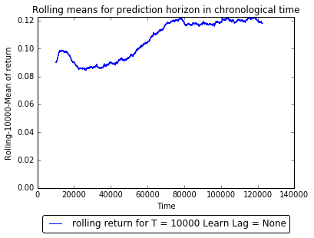
2. Combination of Laws and Objects – Returns at Lending Club
Question: If a prediction horizon of TP=10,000 loans is presumed, how great were the minimal and maximal return of the portfolio?
Answer: For $T=10000$ ${\overline{r}}_{t,T} was always \left(∀t\right)$ in the intervall [0.08446…0.122775]
Law | Description | TP | Div(TP) | Min(TP) | Max(TP) | Mean(TG)
1a | $$∀t≥0(T=TP)({\overline{r}}_{t,T}∈[0.08446…0.122775))$$ | 10000 | 11.2444 | 0.08446 | 0.122775 | 0.105889

Slide 12
2. Combination of Laws and Objects – Returns at Lending Club
Question: Are there loan selection strategies that would produce a different average return in time windows of length T than all of the loans in the respective time window?
Approach:
Simple selection strategy based on the rating by Lending Club:
Prediction Horizon: T=10,000 observations
Evaluation Sample of 15,000 observations (1.5 times the prediction horizon)

Slide 13
2. Combination of Laws and Objects – Returns at Lending Club
So far in every sequence of length T=10,000 it has been the case:
The average excess return of all D rated loans was in the interval [0.003592…0.048566]
The number of D rated loans was in the interval [890…1720]
For every sequence of T>=TU=7,275 loans it has been the case that the average return of D rated loans was greater or equal to the average return of all 7,275 loans.
Since patterns in the form of: „sequence of D (A) rated loans in a sequence of T=10,000 observations“ are antecedents of multiple consequents, these patterns are called „objects“
Law | Description | TP | Div(TP) | Min(TP) | Max(TP)
2 | $$∀t≥0(∀T=TP({\overline{r}}_{t,T,grade=D}≥{\overline{r}}_{t,T}))$$ | 10000 | 9.7444 | 0.003592 | 0.048566
3 | $$∀t≥0(∀T=TP({\overline{r}}_{t,T,grade=A}≤{\overline{r}}_{t,T}))$$ | 10000 | 9.7444 | -0.050061 | -0.007671
Law |  | Mean(TG) | ObsMin | ObsMax
2a | $$∀t≥0(∀T=TP(size(grade=D)∈[890…1720]))$$ | 0.024417 | 890 | 1720
3a | $$∀t≥0(∀T≥TP(size(grade=A)∈[1461…4091]))$$ | -0.032336 | 1461 | 4091
Law |  | TU | Div(TU) | Min(TU) | Max(TU)
2b | $$∀t≥0(∀T=TU({\overline{r}}_{t,T,grade=D}≥{\overline{r}}_{t,T}))$$ | 7275 | 13.768935 | 0.000031 | 0.054608
3b | $$∀t≥0(∀T=TU({\overline{r}}_{t,T,grade=A}≤{\overline{r}}_{t,T}))$$ | 5669 | 17.952902 | -0.05181 | -0.000036

Slide 14
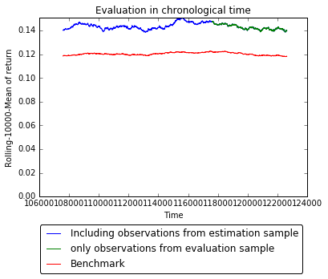
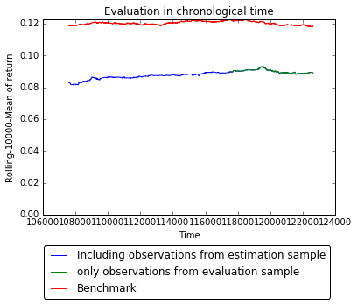
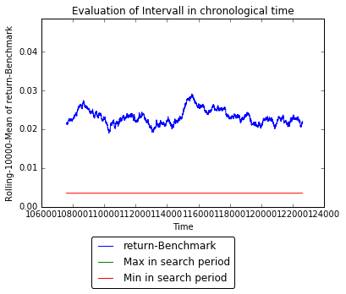
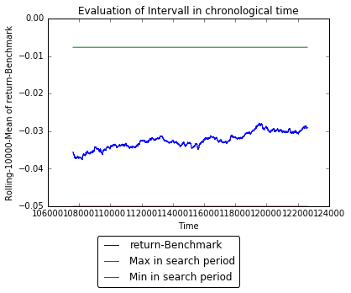
2. Combination of Laws and Objects – Returns at Lending Club
Selection of a decision rule Evaluation of the predictions:
based on T-Dominance
(grade=D) (grade=A)
T-Dominance of D:
So far D would have always been better than A (in all sequences of length 10,000).
RAPM based decision
RAPM can contradict the
Dominance-Criteria!!
 | Sharp-Ratio | RAROC (0.001)
A | 15.8 | 5.43
D | 13.8 | 2.49

Slide 15
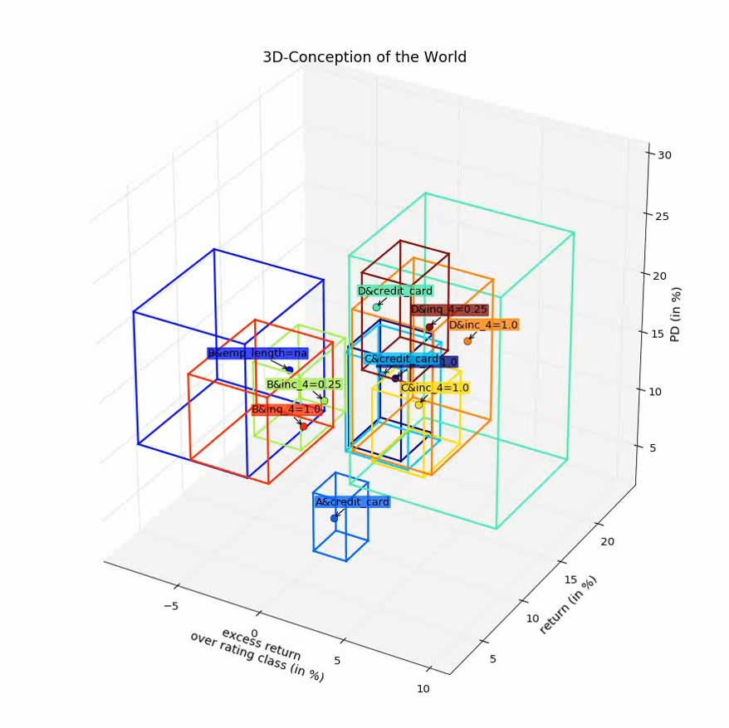
2. Combination of Laws and Objects – Returns at Lending Club
In this example Objects were searched, which always had a postive return, always had a difference relative to the average return (excess return) and always had a difference relative to the average return of the respective rating class (excess RK). (prediction horizon TP=15,000)
Until now always true properties and current state of multiple objects.
Displayed Properties:
mean(return,TP)
mean(excess return RK,TP)
mean(PD,TP)
Next Steps
Movement
Object „Me“
Encompassing / inner System
Cube $W$: A&credit_card
Description | TP | Min(T) | Max(T)
$$∀t≥0(∀T≥TP({\overline{r}}_{t,T,W}≥0))$$ | 15000 | 6.9% | 9.6%
$$∀t≥0(∀T≥TP({\overline{r}}_{t,T,W}≥{\overline{r}}_{t,T}))$$ | 15000 | -3.3% | -0.4%
$$∀t≥0(∀T≥TP({\overline{r}}_{t,T,W}≥{\overline{r}}_{t,T,grade=A}))$$ | 15000 | 0.2% | 2.2%
$$∀t≥0(∀T≥TP({\overline{PD}}_{t,T,W}≥{\overline{r}}_{t,T}))$$ | 15000 | 2.9% | 8.0%
$$∀t≥0(∀T≥TP({\overline{LGD}}_{t,T,W}≥{\overline{r}}_{t,T}))$$ | 15000 | -39.6% | -22.5%

Slide 16
2. Kombinantion von Gesetzen und Prognosen – Volatilität und Rendite des DJ
2. Kombinantion von Gesetzen und Prognosen – Volatilität und Rendite des DJ
2. Combination of Laws and Objects – Returns at Lending Club
Emergent Laws with a constant data basis always provide consistent results.
Instead of making assumptions about multivariate relative frequencies in infinity it is possible to find many conditions (objects), for which multiple decision-relevant statements about functions of sequenes of observations were always true.
Thereby it is possible to define empirical knowledge, which is extracted from databases, as emergent laws about relevant properties of objects.
This justifies (most of the time) the selection of decision rules solely based on T-Dominance: „Behave yourself according to the decision rule that always had better overall results after T-Decisions compared to a benchmark.“
The combination of objects allows the construction of a so far always true conception of the world for predictions about many relevant properties of objects in the world over a (mostly endogenous) prediction horizon.

Slide 17
3. Comparison with Machine Learning Algorithms
In the current praxis the estimation errors of already falsified models (which make estimations for the value‘s next observation of an endogenous variable) are used as a basis for the evaluation of the models‘ quality.
In general it is not the goal of the system to derive a point estimate from emergent laws. However by creating point estimations it is possible to compare the relative forecasting quality using standard error metrics.
The results (illustrated in the table on the next slide) show that the predictions‘ quality by the approach introduced here (ELBMB ≙ Emergent Law Based Model Building) is in the same quality grade like modern machine learning algorithms.

Slide 18
3. Comparison with Machine Learning Algorithms
ELBMB ≙ Emergent Law Based Model Building (approach from this presentation)
Example: | Approach | mean absolute error | root mean squared error | mean absolute percentage error | mean relative squared error
Bike | RandomForest | 33.77 | 57.47 | 0.19015 | 0.05907
 | GradientBoosting | 40.56 | 62.1 | 0.22843 | 0.06897
 | ELBMB | 27.9 | 45.04 | 0.15711 | 0.03628
temp | RandomForest | 0.01533 | 0.02523 | 0.08864 | 0.01633
 | GradientBoosting | 0.01343 | 0.01954 | 0.07764 | 0.00979
 | ELBMB | 0.1278 | 0.02036 | 0.07393 | 0.1064
hum | RandomForest | 0.03857 | 0.05236 | 0.26606 | 0.09376
 | GradientBoosting | 0.03642 | 0.05055 | 0.25123 | 0.0874
 | ELBMB | 0.03655 | 0.05414 | 0.25219 | 0.10023
SuP_Rend | RandomForest | 0.0078 | 0.0115 | 1.03072 | 1.03871
 | GradientBoosting | 0.00762 | 0.01134 | 1.00747 | 1.00941
 | ELBMB | 0.00755 | 0.01122 | 1.0017 | 1.0017
SuP_Vola | RandomForest | 0.00516 | 0.00761 | 0.97864 | 0.83302
 | GradientBoosting | 0.005 | 0.0075 | 0.94824 | 0.80866
 | ELBMB | 0.00495 | 0.00749 | 0.93986 | 0.81224

Slide 19
4. Reliability and Meta-Laws
Question:
What can be said in general about the frequency of true predictions with emergent laws?
Approach:
Search for Laws in the database at time t and verification of their predictions at time t+T
A wrong prediction shows that a new pattern occurred for the first time which was so far never observed before!
Searched for laws in the form of $∀t_{j}({mean}_{T}\left(y_{t}−{\overline{y}}_{t}|x_{i}=x_{i,j}\right)≥\left(≤\right)0)$
Rate of true predictions: $Rel=\frac{Confirmed Predictions}{Predictions with Div−times confirmed Laws}$
Classification of laws into Div-Classes (Objects)

Slide 20
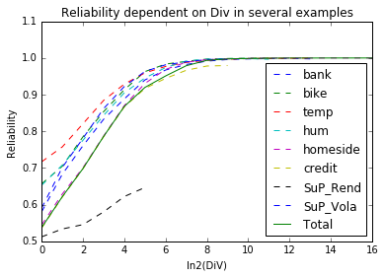
4. Reliability and Meta-Laws
Results:
 | AnzH_Total | AnzB_Total | Reliability_Total
DiV<1 | 3755762004 | 2018839398 | 0.537531
1<=DiV<2 | 1847883992 | 1149058410 | 0.621824
2<=DiV<4 | 1777168036 | 1241134884 | 0.698378
4<=DiV<8 | 1258863834 | 989538652 | 0.786057
8<=DiV<16 | 701756106 | 608925678 | 0.867717
16<=DiV<32 | 308575195 | 283810805 | 0.919746
32<=DiV<64 | 92386925 | 87853317 | 0.950928
64<=DiV<128 | 20671177 | 20234296 | 0.978865
128<=DiV<256 | 6413360 | 6371912 | 0.993537
256<=DiV<512 | 3017190 | 3009240 | 0.997365
512<=DiV<1024 | 1465252 | 1463322 | 0.998683
1024<=DiV<2048 | 723926 | 723522 | 0.999442
2048<=DiV<4096 | 408612 | 408527 | 0.999792
4096<=DiV<8192 | 224394 | 224354 | 0.999822
8192<=DiV<16384 | 116534 | 116527 | 0.999940
16384<=DiV<32768 | 74363 | 74360 | 0.999960
DiV>=32768 | 25971 | 25970 | 0.999961
The more frequently a pattern was always observed before, the higher the relative frequency of true predictions and the rarer the appearance of patterns never observed before.

Slide 21
4. Reliability and Meta-Laws
Question: Is it possible to find laws about the predictive performance of emergent laws?
1. For emergent laws with a certain degree of verification DiV, there was always a number of predictions TU for which a certain Reliability r was always reached:
(For T>=Tu applies: $∀t\left(Rel\left({DiV}_{t},T\right)≥r\right)$)
Reliability-Level | 0.6 | 0.7 | 0.8 | 0.9
1<=DiV<2 | 624935 | kein TU | kein TU | kein TU
2<=DiV<4 | 282039 | 1077154 | kein TU | kein TU
4<=DiV<8 | 100512 | 625659 | kein TU | kein TU
8<=DiV<16 | 76719 | 186659 | 1276499 | kein TU
16<=DiV<32 | 101404 | 161387 | 360278 | kein TU
32<=DiV<64 | 5564 | 9266 | 19889 | 211025
64<=DiV<128 | 2320 | 3438 | 6792 | 41450
128<=DiV<256 | 1295 | 1901 | 7961 | 18263
256<=DiV<512 | 723 | 1062 | 3096 | 6486
512<=DiV<1024 | 440 | 661 | 1324 | 2429
1024<=DiV<2048 | 60 | 75 | 269 | 829
2048<=DiV<4096 | 11 | 13 | 122 | 248
Div>=4096 | 30 | 30 | 30 | 62

Slide 22
4. Reliability and Meta-Laws
2. There was always a number of predictions T for which the Reliability of better confirmed laws was higher.
(There was a T for all ${DiV}_{G}>{DiV}_{K}$ w$ith ∀t\left(Rel\left({DiV}_{G},T\right)≥Rel\left({DiV}_{K},T_{K,t}\right)\right)$)
DiV (G,K) | 1 | 2 | 4 | 8 | 16 | 32 | 64 | 128 | 256 | 512 | 1024
1<=DiV<2
2<=DiV<4 | 83900
4<=DiV<8 | 107450 | 255250
8<=DiV<16 | 46150 | 136800 | 89750
16<=DiV<32 | 44700 | 47050 | 47550 | 137250
32<=DiV<64 | 43000 | 46500 | 45850 | 45350 | 56950
64<=DiV<128 | 42250 | 45300 | 45350 | 44250 | 57450 | 58600
128<=DiV<256 | 39050 | 41050 | 41150 | 40050 | 47200 | 47150 | 41700
256<=DiV<512 | 33450 | 35150 | 35000 | 34450 | 34200 | 35650 | 34550 | 32350
512<=DiV<1024 | 1270 | 1440 | 6960 | 8680 | 14600 | 5760 | 25900 | 4940 | 24600
1024<=DiV<2048 | 500 | 485 | 2420 | 3720 | 5680 | 1910 | 2410 | 2740 | 2810 | 12680
2048<=DiV<4096 | 115 | 195 | 805 | 1500 | 2030 | 505 | 545 | 765 | 845 | 1410 | 2440
Div>=4096 | 30 | 10 | 10 | 25 | 10 | 190 | 145 | 195 | 200 | 215 | 405

Slide 23
4. Reliability and Meta-Laws
(DiV/T)-Classes of laws are a-priori objects, independent from the concrete contents.
Since there are empirical laws about properties of objects, spanning over different prediction problems and databases, the transfer of a-priori knowledge about the Reliability of different kinds of laws to new learning tasks is possible.
For example the application of the learning strategy – always choose the law with the highest DiV – to a new problem is itself justified by an empirical law.
In this way metaphysical assumptions regarding probability distributions can be replaced by emergent laws about the predictive quality of (DiV/T)-Objects.

